Slide 1
Chapter Seventeen
Can Computers Think?

Slide 2
Think?
What do we mean by thinking?
By consciousness?
Do whales, dolphins, chimpanzees think?
Are they conscious?
Aren’t we all just a collection of electrical signals?

Slide 3
Thinking
Training from known example
Trying alternatives and permuting
Hill-climbing
Genetic algorithms
Database of facts
Cyc is an artificial intelligence project that attempts to assemble a comprehensive ontology and knowledge base of everyday common sense knowledge, with the goal of enabling AI applications to perform human-like reasoning
Notes:
https://en.wikipedia.org/wiki/Cyc

Slide 4
Turing Test
A computer and a human communicate with another human
If second human correct 50% of time, computer thinking
But
Has to be able to type; dolphins can’t
What if person deaf or blind?

Slide 5
Thinking
Are there tasks that appear to require thought but that don’t?

Slide 6
Examples
Medical programs that are as good as experts in diagnoses
Word recognition and response
Chess – Deep Blue
Jeopardy – Watson

Slide 7
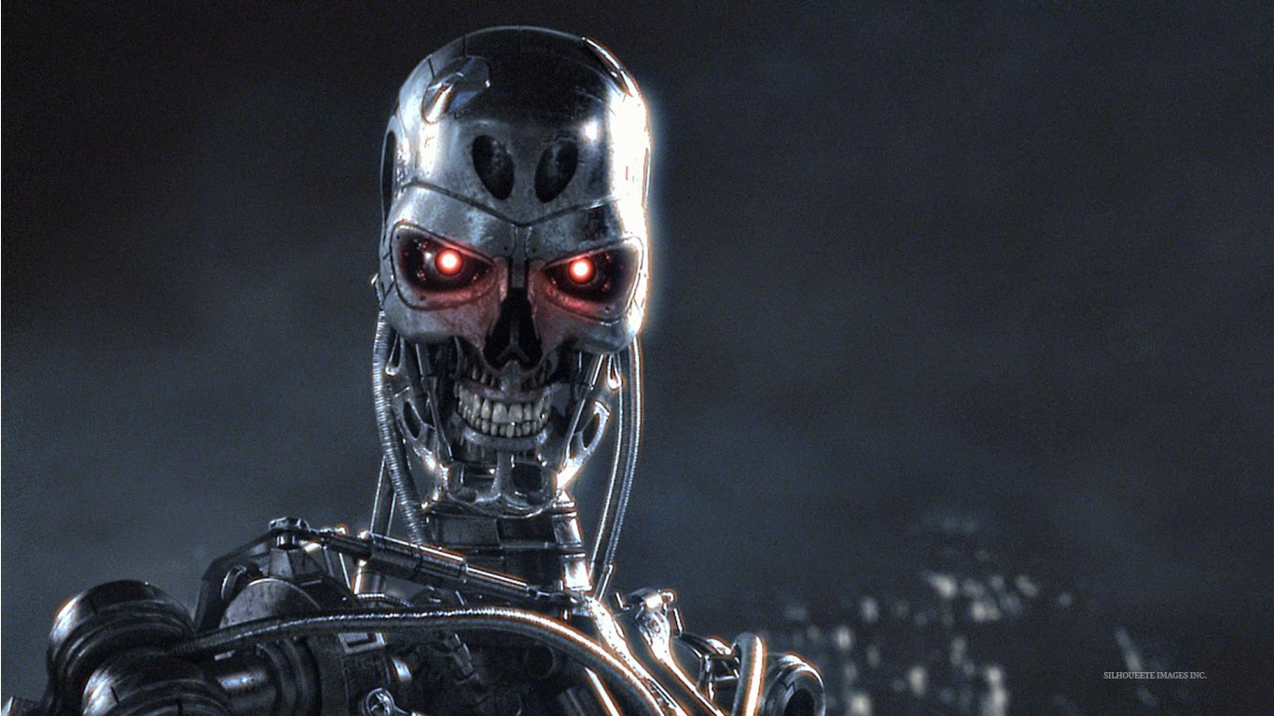
Why Worry?

Slide 8


Slide 9

Why Worry?

Slide 10
Why Worry?
Autonomous Weapons: an Open Letter from AI & Robotics Researchers
Research Priorities for Robust and Beneficial Artificial Intelligence
Stephen Hawking, Elon Musk, Steve Wozniak…

Slide 11
Review
Questions: 1, 3, 7, 10

